Slide 1

WELCOME

Slide 2
GRIEVANCE Redressal ColLege Portal
CREATED BY: MR SARGAR SACHIN SOMNATH
UNDER THE GUIDANCE OF : PROF.Akash Raut

Slide 3

INDEX
INTRODUCTION
SCOPE OF SYSTEM OBJECTIVE
PURPOSE OF SYSTEM
FEASIBILITY STUDY
FUNCTIONAL REQUIREMENTS
NON FUNCTIONAL REQUIREMENTS
DIAGRAMS
USER INTERFACE
LIMITATIONS OF PROPOSED SYSTEM
PROPOSED ENHANCEMENTS
PROJECT GOAL
CONCLUSION

Slide 4
INTRODUCTION
College is not just a place for education, but also for personal growth and development. However, students may face various issues related to academics, facilities, or staff behavior during their time on campus. Traditionally, reporting these problems involves writing letters or meeting faculty, which is often slow and ineffective. To address this, a digital Grievance Redressal Portal has been introduced to simplify complaint submission and ensure faster, more transparent resolutions.

Slide 5
SCOPE OF SYSTEM
Allows students to register, login, submit complaints, track their complaint status, and view profile information.
Allows administrators to manage complaints, resolve issues, publish notices, and monitor student feedback.
Ensures secure authentication, real-time tracking, and centralized data storage.
Can be extended to include department and student history tracking.

Slide 6
PURPOSE OF SYSTEM AND OBJECTIVE
The main objective of the Grievance Redressal College Portal is to make it easy for students to submit complaints online and track their status. It helps students avoid the hassle of visiting offices and ensures their issues are heard. The portal also helps college staff view, respond to, and resolve complaints quickly. By keeping everything digital, the system increases transparency and saves time. It also allows admins to share important updates and notices directly with students.

Slide 7

FEASIBILITY STUDY
Technical Feasibility
Built using the MERN stack (MongoDB, Express, React, Node).
Open-source, scalable, and cross-platform compatible.
👥 Operational Feasibility
User-friendly interface for students and admins.
Minimal training needed due to intuitive design.
💰 Economic Feasibility
No licensing costs – uses free technologies.
Development with free tools like VS Code & Postman.

Slide 8
FUNCTIONAL REQUIREMENTS
✓ Security: The portal must enforce strong authentication and role-based access control to protect user data and prevent unauthorized access.
✓ Scalability: The architecture should support the addition of more users (students and admins) and future features without affecting performance.
✓ Performance: The system should respond quickly to user actions, even under moderate to high load, ensuring a smooth experience.
✓ Usability: The user interface must be simple, intuitive, and user-friendly, allowing users to easily navigate the system with minimal training.

Slide 9
NON FUNCTIONAL REQUIREMENTS
Reliability
System must operate consistently without failures.
Ensures complaint data is safely stored and retrievable.
Maintainability
Codebase should be easy to update and debug.
Supports future enhancements with minimal effort.
Availability
Portal should be accessible 24/7.
Ensures continuous access for students and admins.
Portability
Runs on all modern browsers and devices.
No OS dependency—platform-independent.

Slide 10
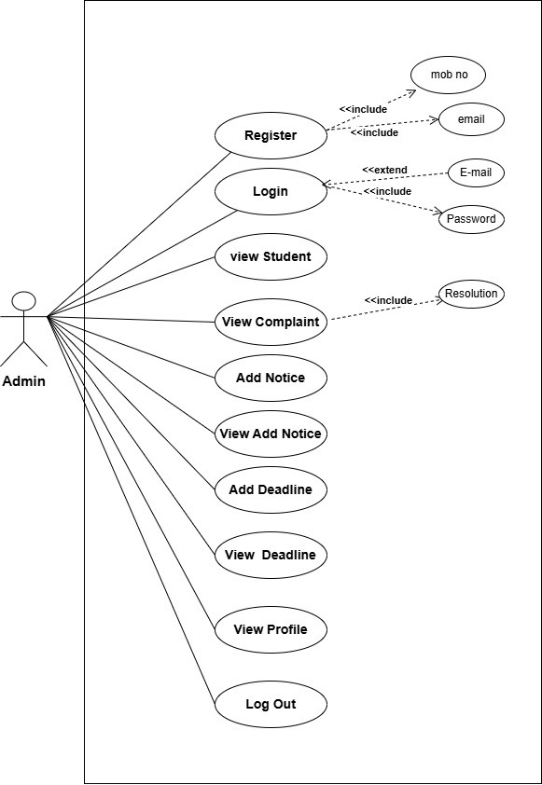
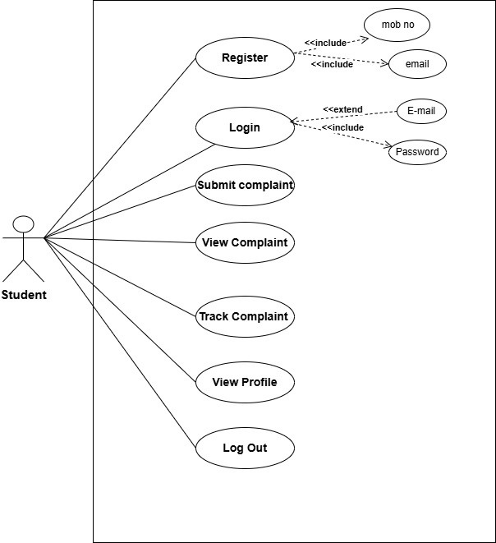
DIAGRAMS
Use Case Diagram

Slide 11
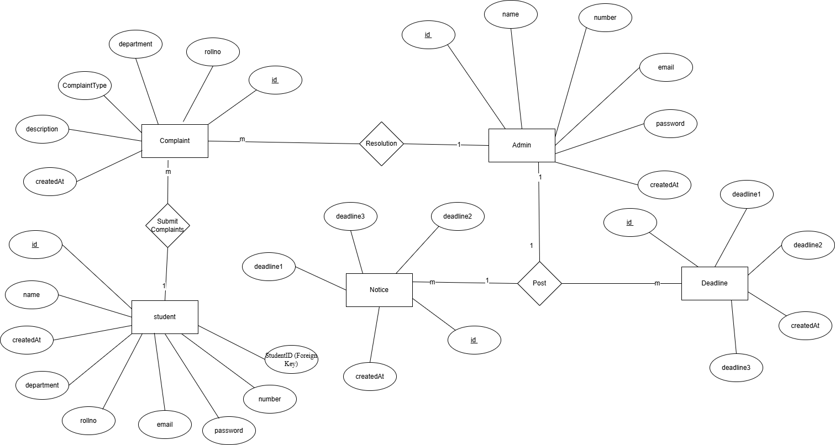
ER Diagrams

Slide 12
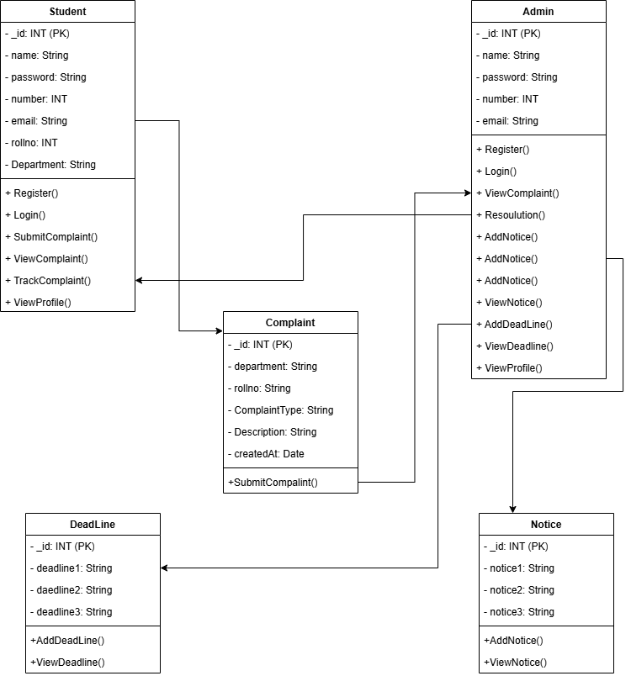
Class Diagram

Slide 13
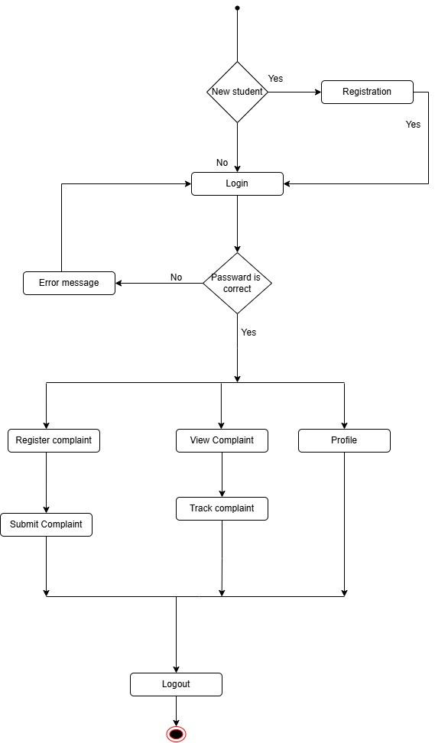
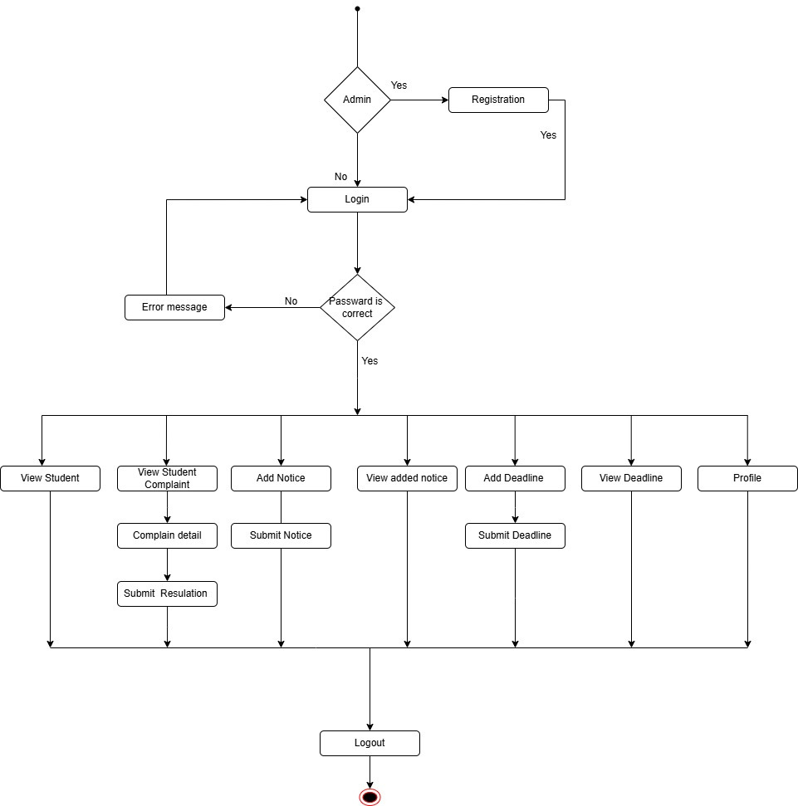
Activity Daigram

Slide 14
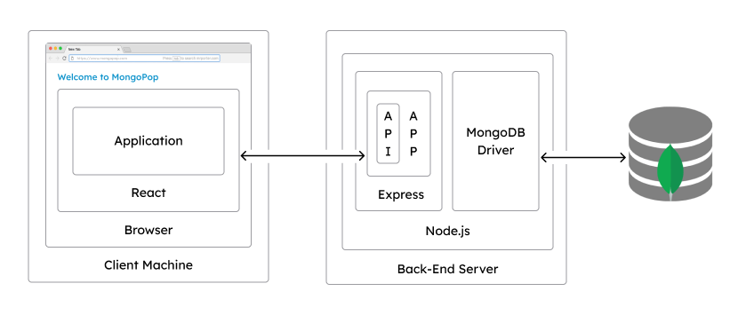
Deployment Daigram

Slide 15
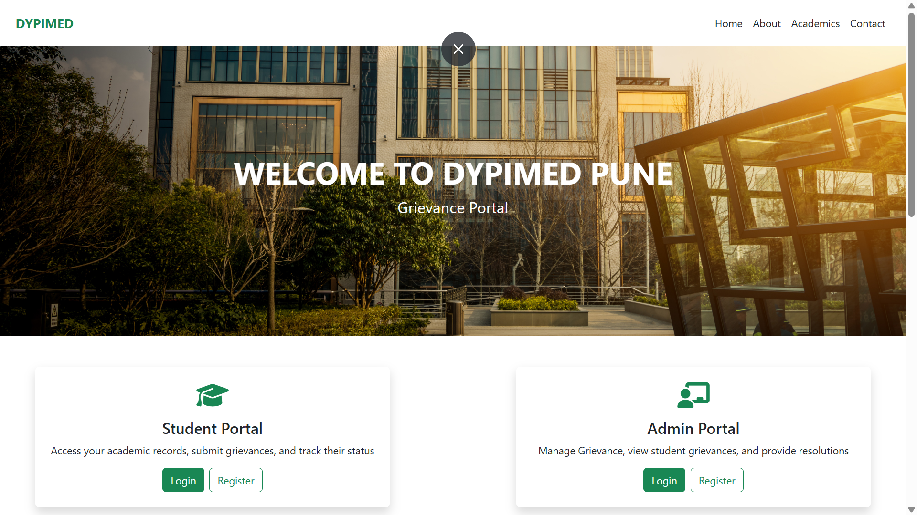
USER INTERFACE

Slide 16
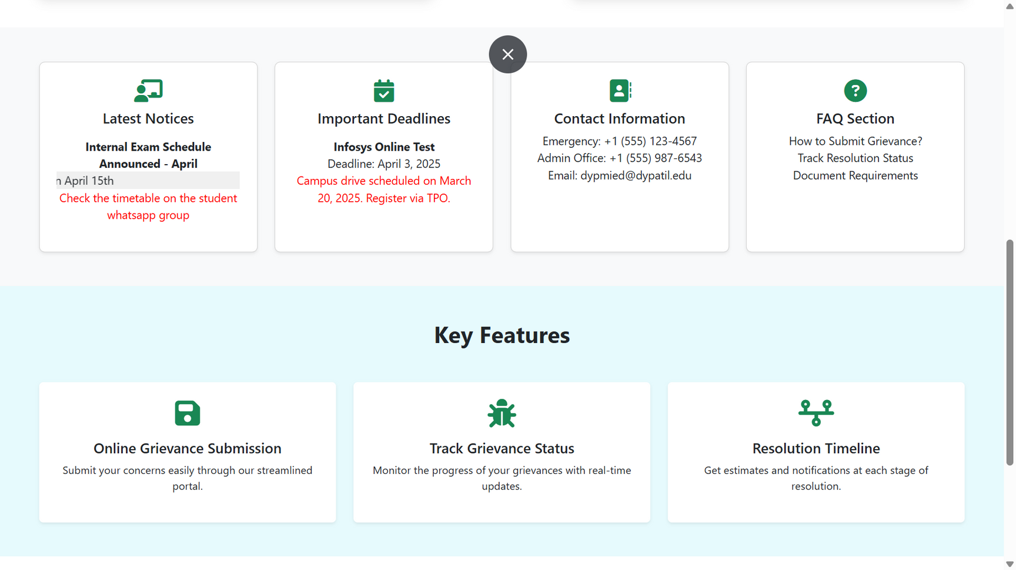
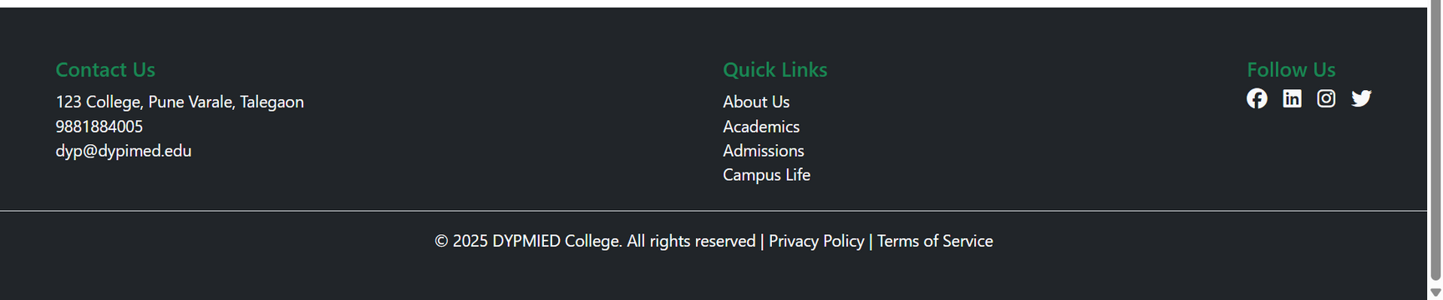

Slide 17
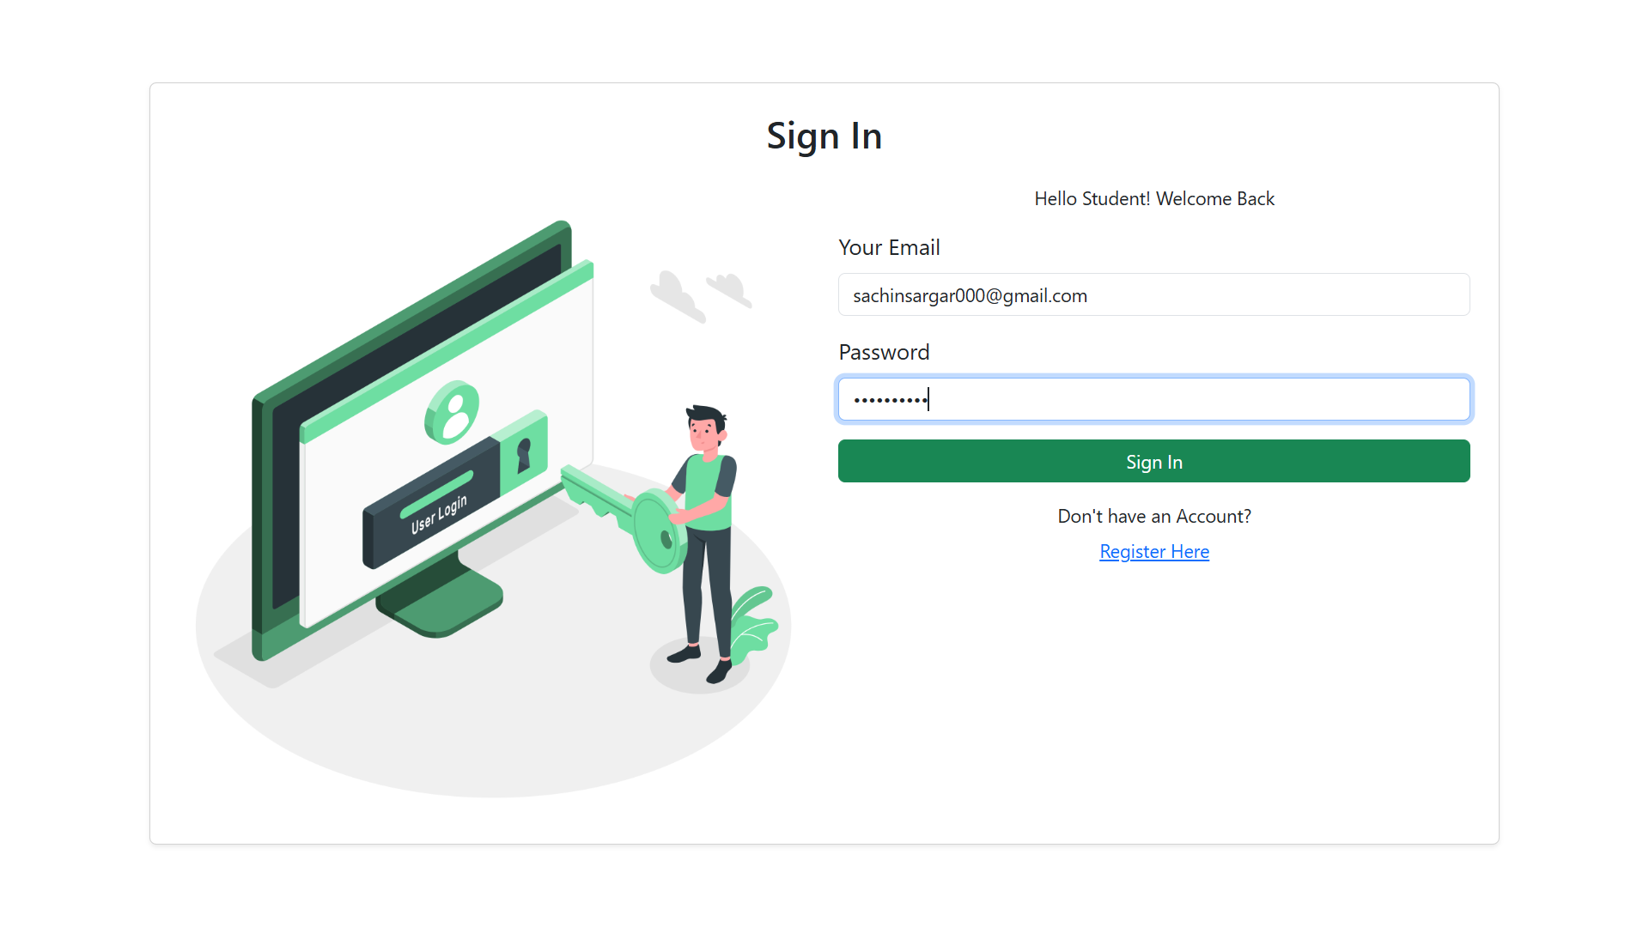
Student Login and Register

Slide 18
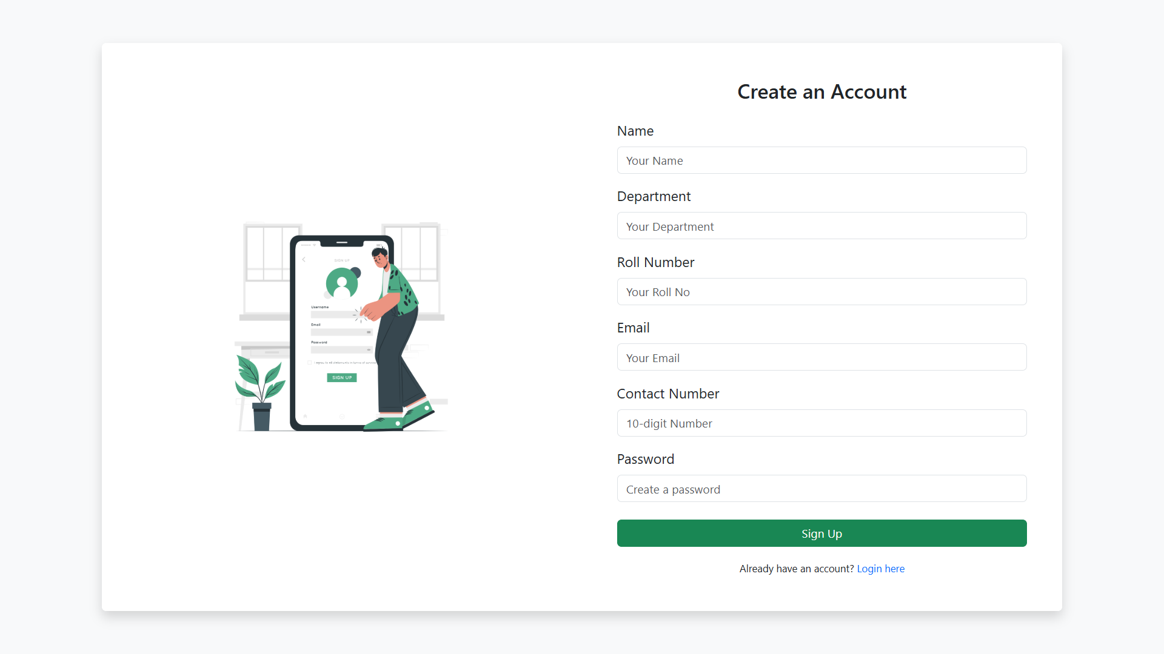

Slide 19
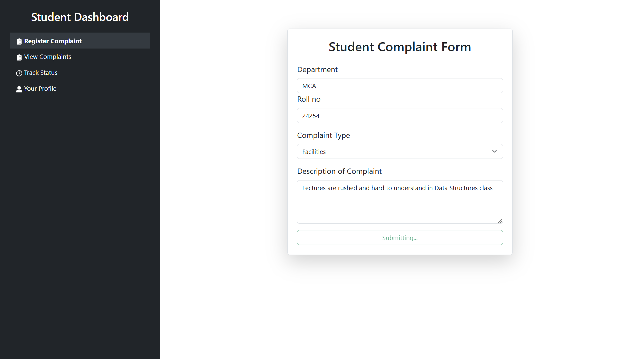
student Dashboard

Slide 20
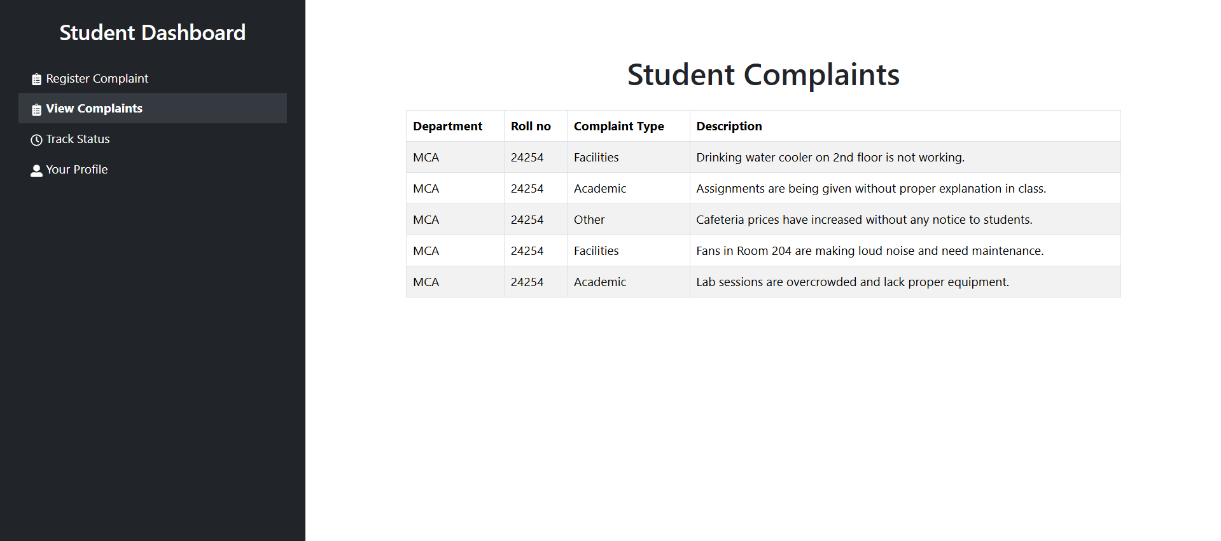
Veiw Complaint

Slide 21
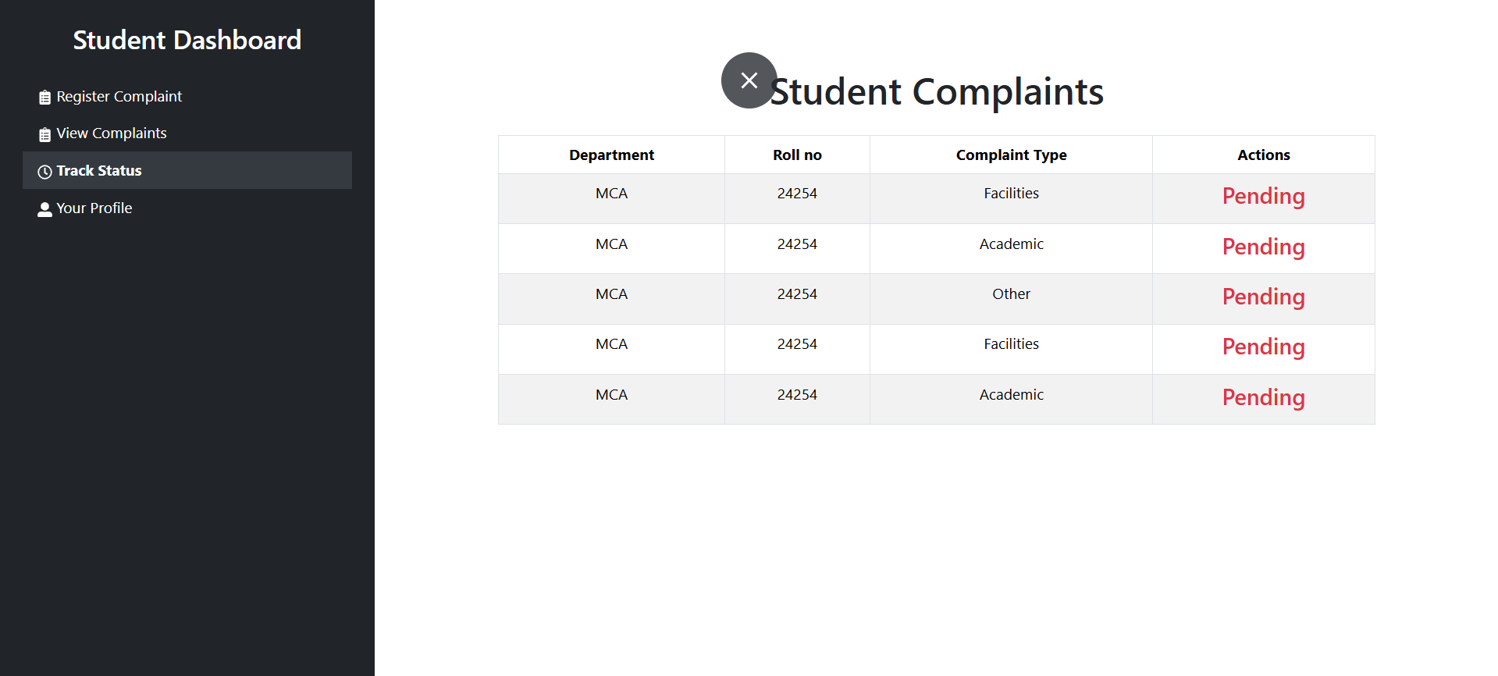
Track Complaint

Slide 22
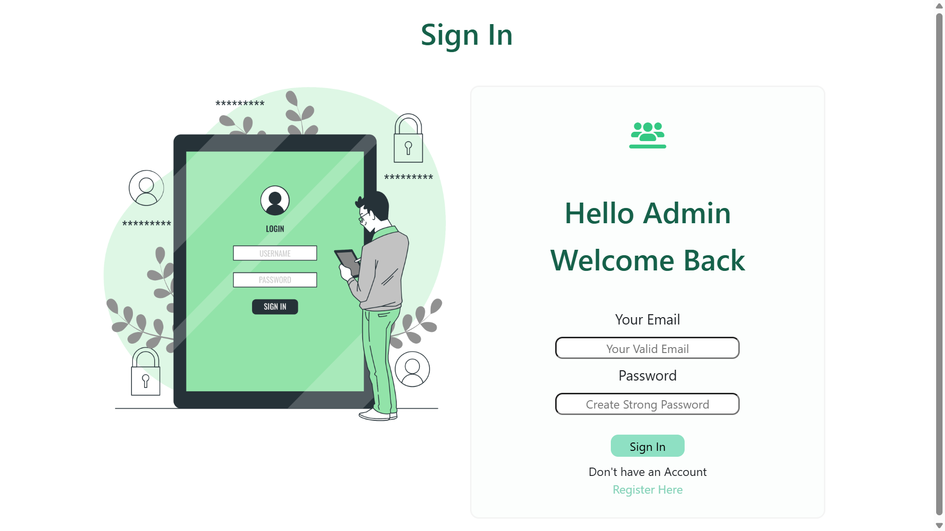
Admin Login And Register

Slide 23
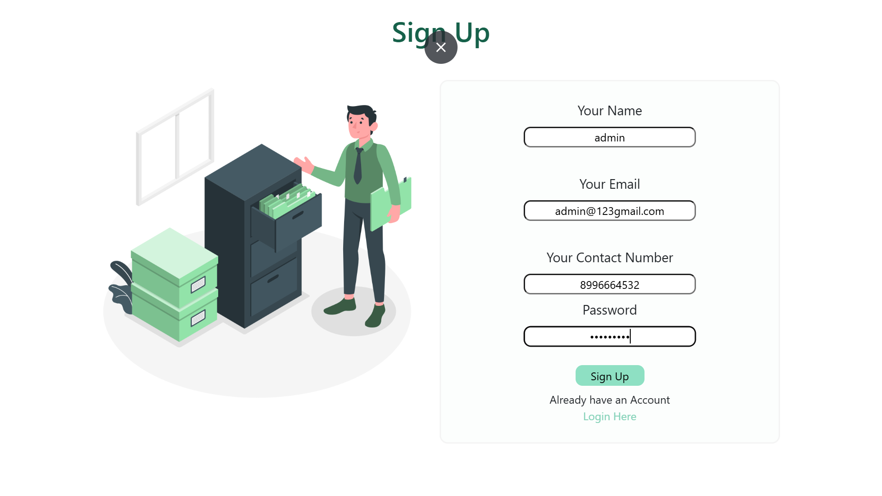

Slide 24
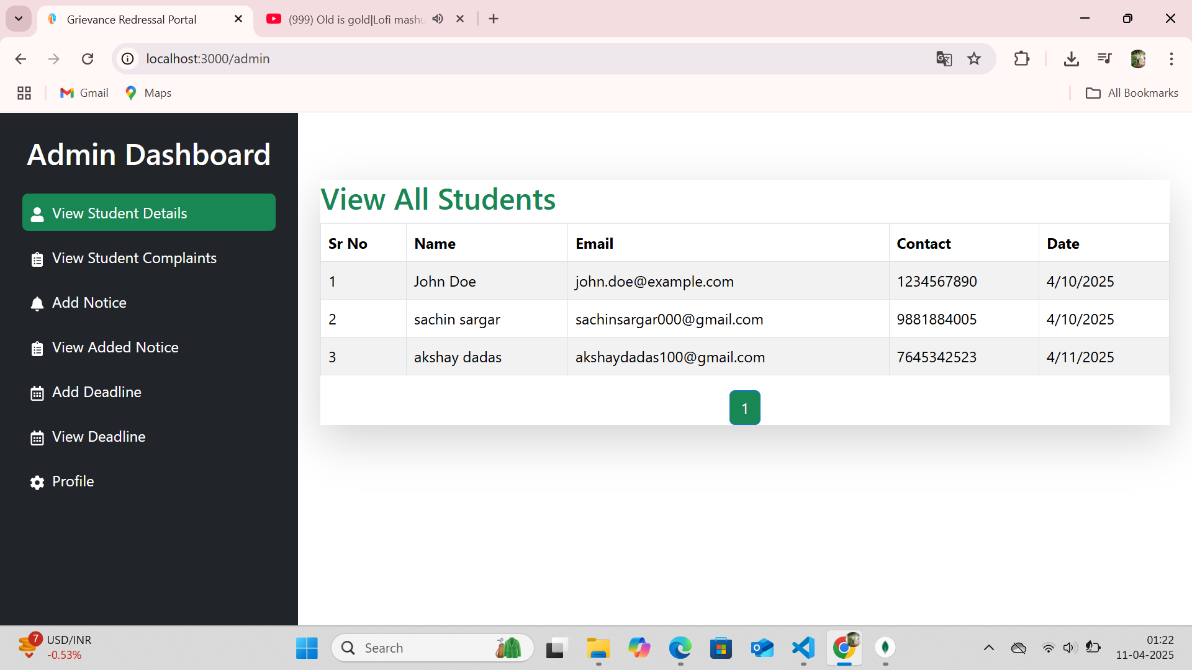
View Student User

Slide 25
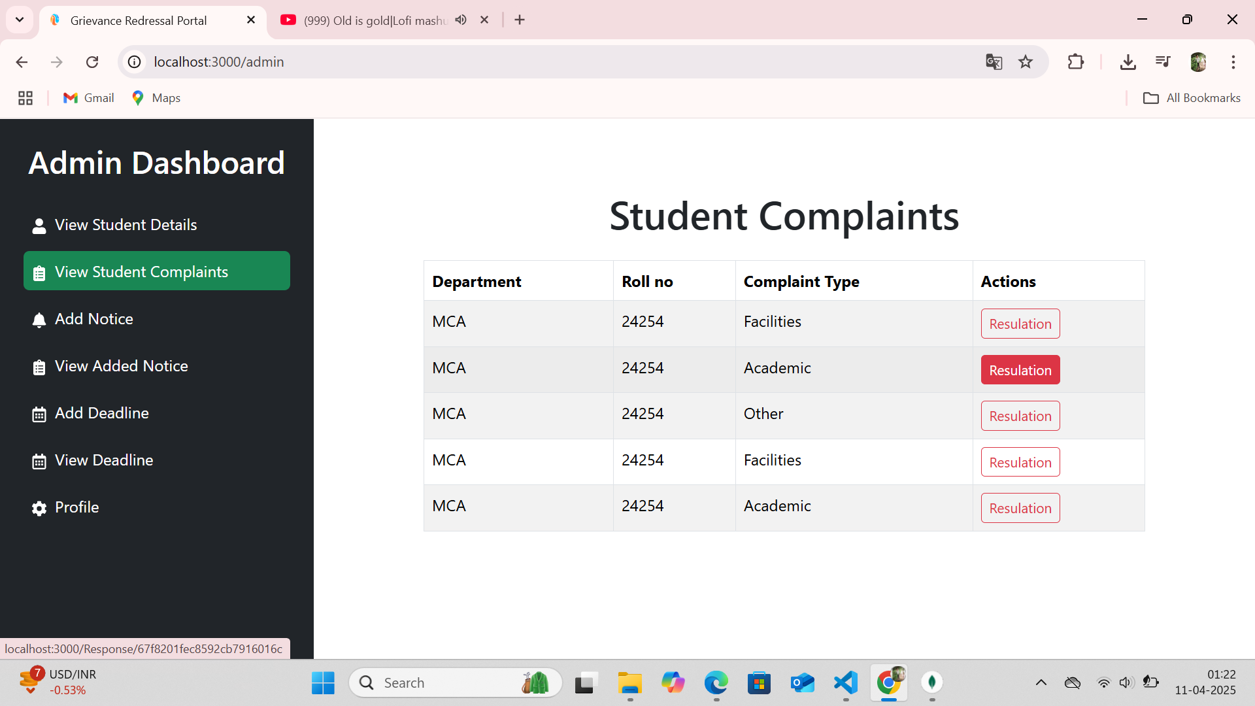
View Student Complaint

Slide 26
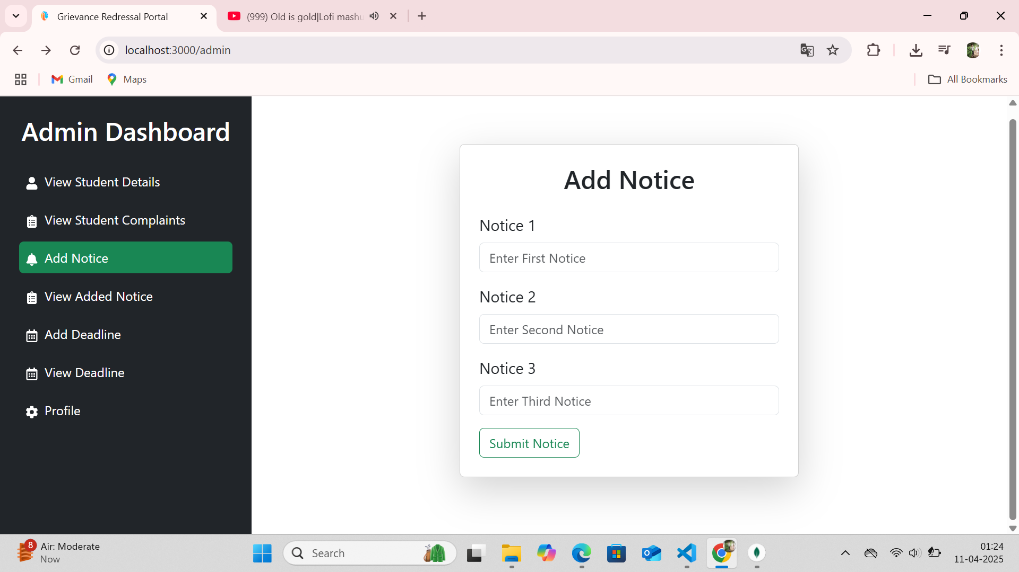
Add Notice

Slide 27
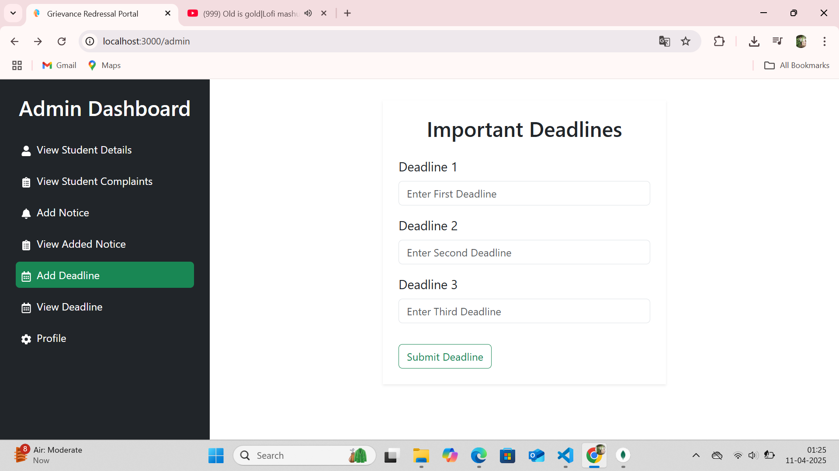
Add DeadLine

Slide 28
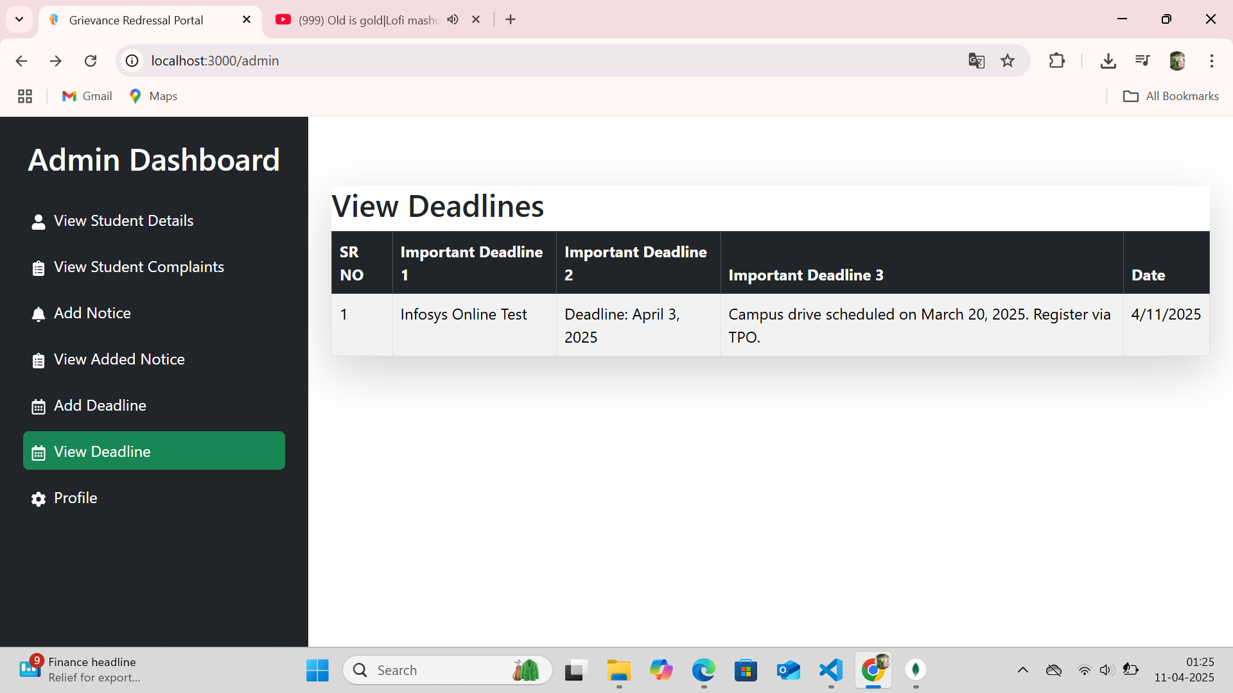
View DeadLine

Slide 29
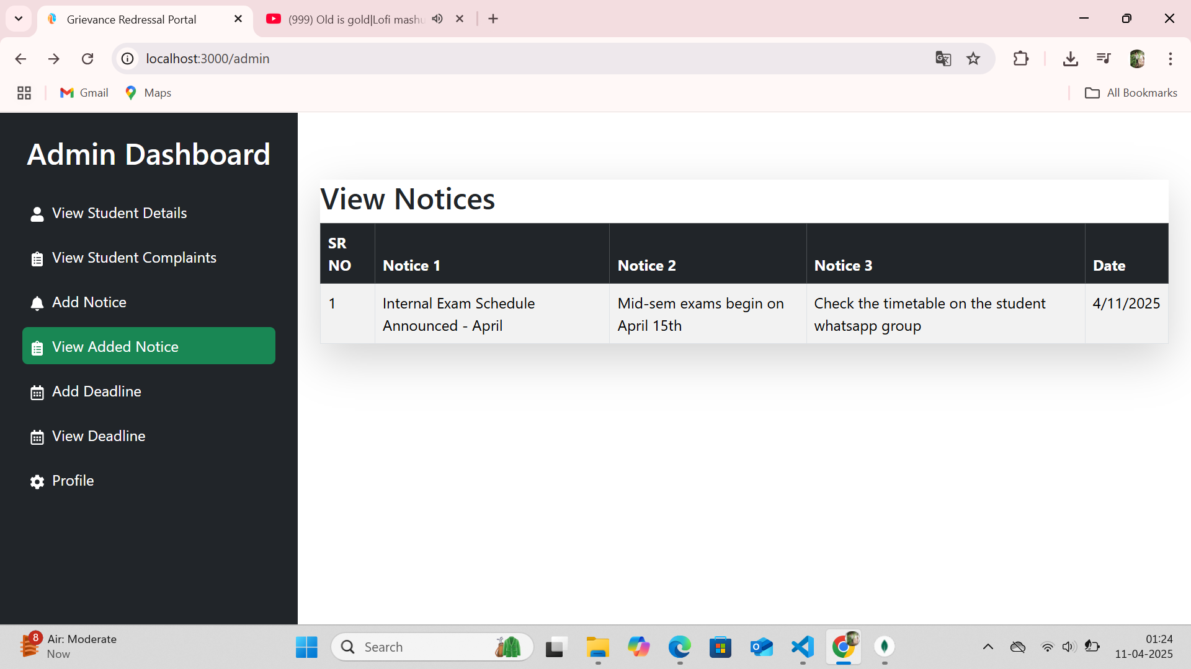
View Notice

Slide 30
LIMITATIONS OF PROPOSED SYSTEM
No support for complaint categorization by department
No escalation workflow for unresolved complaints
Limited notification system (no email/SMS)
No user feedback system after complaint resolution

Slide 31
PROPOSED ENHANCEMENTS
• Integrate email/SMS notification system
Add complaint categories and departments
Implement escalation policies and response time tracking
• Collect user feedback on resolved complaints
Add analytics dashboard for admins

Slide 32
PROJECT GOALS
01
Provide a simple and effective platform for students to submit and track complaints.
02
Enable admins to manage, respond to, and resolve grievances efficiently.

Slide 33
CONCLUSION
The Grievance Redressal College Portal provides a much-needed solution to the inefficiencies of the traditional paper-based system. It improves transparency, accountability, and communication between students and college authorities. By using modern web technologies and providing real-time updates, this system creates a more reliable environment for grievance management. Future updates can enhance its capabilities and expand its usage across different departments and institutions.

Slide 34
THANK YOU !

